Slide 1
SOFTWARE PROJECT SEMESTER-6
Make Deal
PREPARD BY:
Yash Dhameliya – 165220686009
Krunal Bhanderi - 165220686004
INTARNAL GUIDE
Prof. Amit Gohel

Slide 2
Acknowledgement
It is indeed a great pleasure to express my thanks and gratitude to all those who helped me. No serious and lasting achievement or success one can ever achieve without the help of friendly guidance and co-operation of so many people involved in the work.
I am very thankful to my guide Prof.Amit Gohel, the person who makes me to follow the right steps during a project work. I express my deep sense of gratitude to for her guidance, suggestions and expertise at every stage. A part from that her valuable and expertise suggestion during documentation of my report indeed help me a lot.

Slide 3
Acknowledgement
Thanks to my friend and colleague who have been a source of inspiration and motivation that helped to me during my project work.
I would heartily thankful to Head and Dean of our department Dr. Sunil Bajeja and Dr. R. Sridaran to give me an opportunity to work over this report and for their end-less and great support. And to all other people who directly or indirectly supported and help me to fulfil my task.

Slide 4
Synopsys
Make deal is the platform which provides local communities in high-growth markets with vibrant online marketplaces. Make Deal connects local people to buy, sell or exchange used goods and services by making it fast and easy for anyone to post a listing through their mobile phone or on the web.

Slide 5
Preamble
2.1. Project Details:
Make deal is project of online buy and sell of all products. Users can search the products they want to buy or sell in nearby their area. This website has different variety of products such as electronics, vehicles, furniture, home utilities, sports equipment etc.
Users have to create an account if they want to sell something on this website at best price deal. Users simply post the ad of the product / property they want to sell. Buyers & sellers contact each other with messages or other contact details provided by the sellers. In case of any query user can direct contact to the admin thorough admin feedback box. For post the ad on this website user have to create an account and sign in. Sellers have to add some information about product like photos, price, and product details. When user sign in there provide their buy & sell history.
Second part is of admin. Admin can see all the User details and manage the data. If any post is not proper or negative, then admin can delete that post or block the user.

Slide 6
Preamble
2.1. Project Details:
User can request appointment to the doctor if doctor confirm appointment then mail of confirmation will send. Doctor can prescribe reports and other treatment if needed. After all above process bill will be generated and provided to the patient.

Slide 7
Modules
Categories
Manage Ads(User)
Manage User(Admin)
Manage Ads(Admin)
My Account(User)
About Us
Contact US
Terms&Condition

Slide 8
Modules With Description
Categories
Properties: -
In this module users who want to buy property like lands, shops & offices, House, Flat etc.
Electronics: -
In this module user select the type of electronics like phones, laptops, camera etc.
Sports & Hobbies: -
In this module all type of sports equipment and the things related to hobbies are listed by the sellers.

Slide 9
Modules With Description
Furniture: -
Users can find all the furniture with selecting the type of furniture they require.
Fashion: -
In this Module all the fashionable things like clothes, shoes, jewelries etc. are provided by sellers.
Vehicles: -
In this module all types of vehicles like bikes, cars, commercial vehicles etc. listed to be sold.

Slide 10
Modules With Description
Manage Ads(User)
Ad post:-
User who have to sell something then simply user can post an ad with giving photos & add description and also have to provide contact details so that buyers can direct contact to the sellers.
Remove Post:-
If Product is sold out or some mistakes done at a time of adding a post, then user can delete that post.
List Ads:-
User can see all the ads posted by other users.

Slide 11
Modules With Description
Search: -
In this module users can search what they looking for and also enter the company name. This web site there is providing advance search that is filters like location and price wise.
Manage User(admin): -
If user don’t follow rules and post some improper ads so admin can remove the user.

Slide 12
Modules With Description
Manage Ads(admin): -
Admin can view list of all user’s ads. And also can delete the ads.
My Account(user):-
In this user can get all his details like list of personal detail, posted ads, sold product, my chats, favorite list and update details like contact information, account password.

Slide 13
Modules With Description
About Us:-
This will give information about this site.
Contact Us:-
This will give the contact details of admin like E-mail id, contact detail.
Terms & condition:-
This will give display the rules of using the web site.

Slide 14
Modules With Description
Contact Us
If user want to contact to the hospital or if user has some question about services and Department etc. then this module is used.
About us
About us module shows the all the description about the hospital and its services, location, emergency helpline etc. also this module has feedback facility .if user want to write their view then in feedback section he/she can able to write.

Slide 15
Modules With Description
Categories
This module of system is shown at admin side .Admin can add new doctor, update details of doctor, delete doctor and also able to manage doctor’s scheduled as per availability.

Slide 16
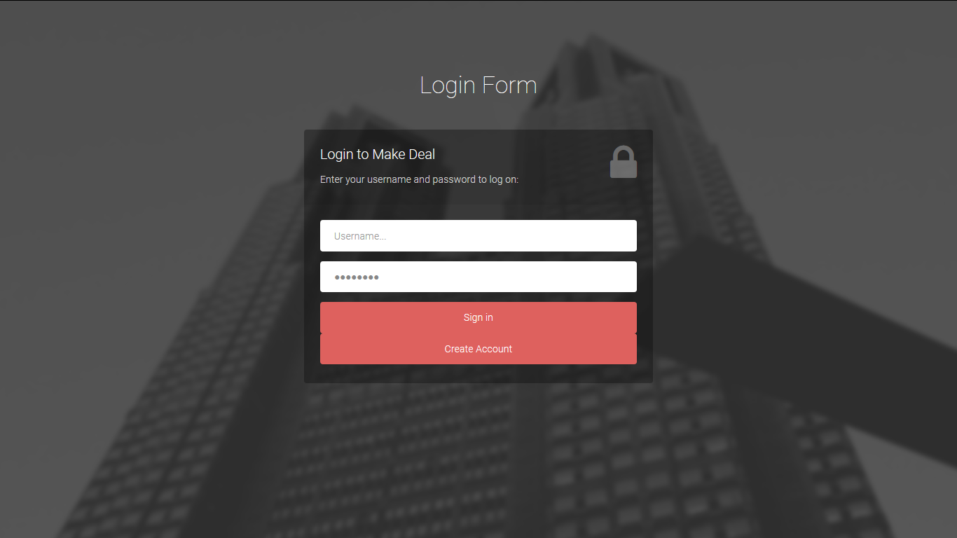
Screenshots
Login Page

Slide 17
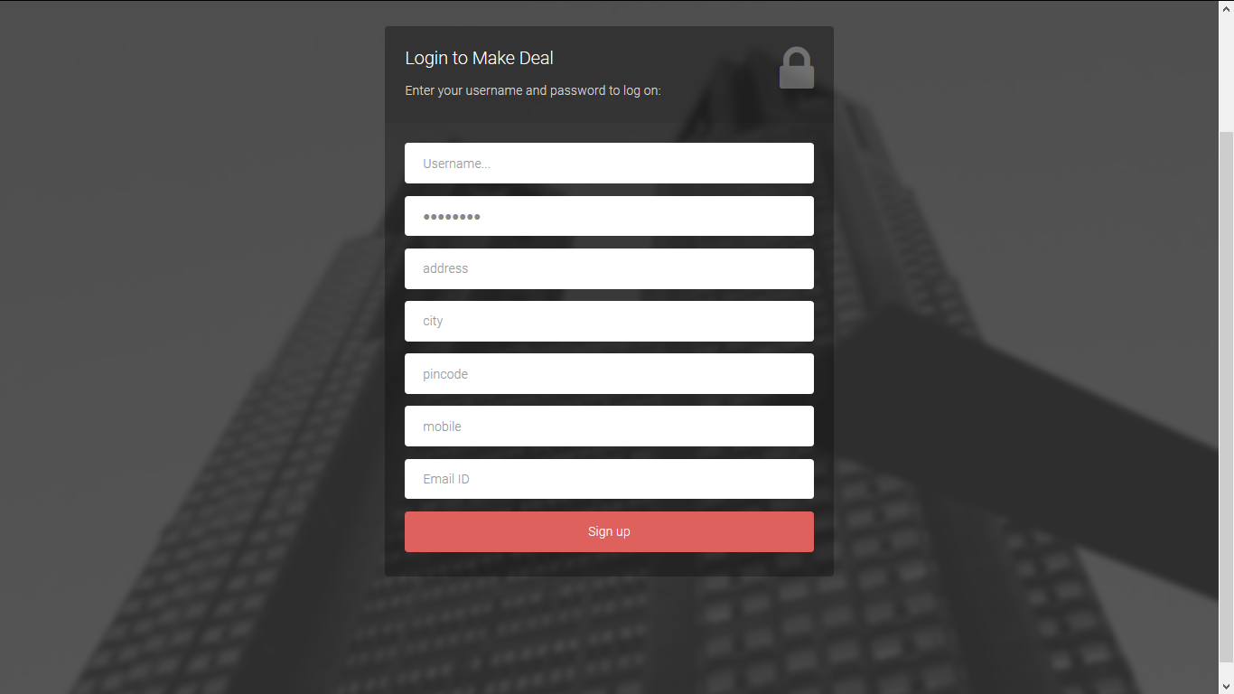
Screenshots
Signup Page

Slide 18
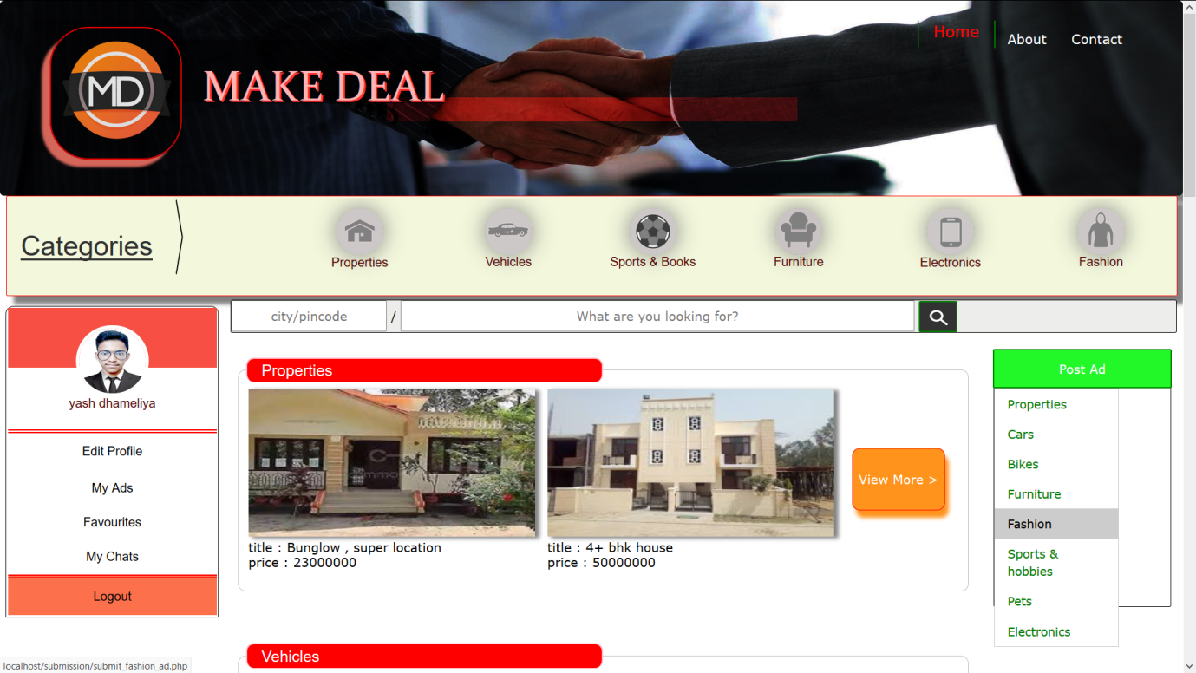
Screenshots
Home Page(user)

Slide 19
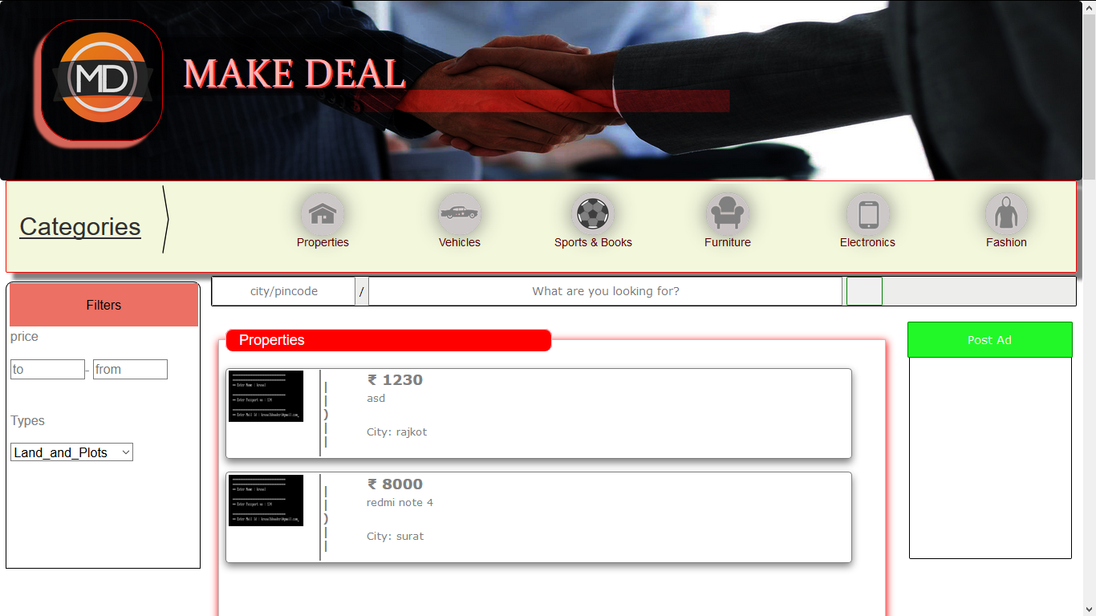
Screenshots
Ads List

Slide 20
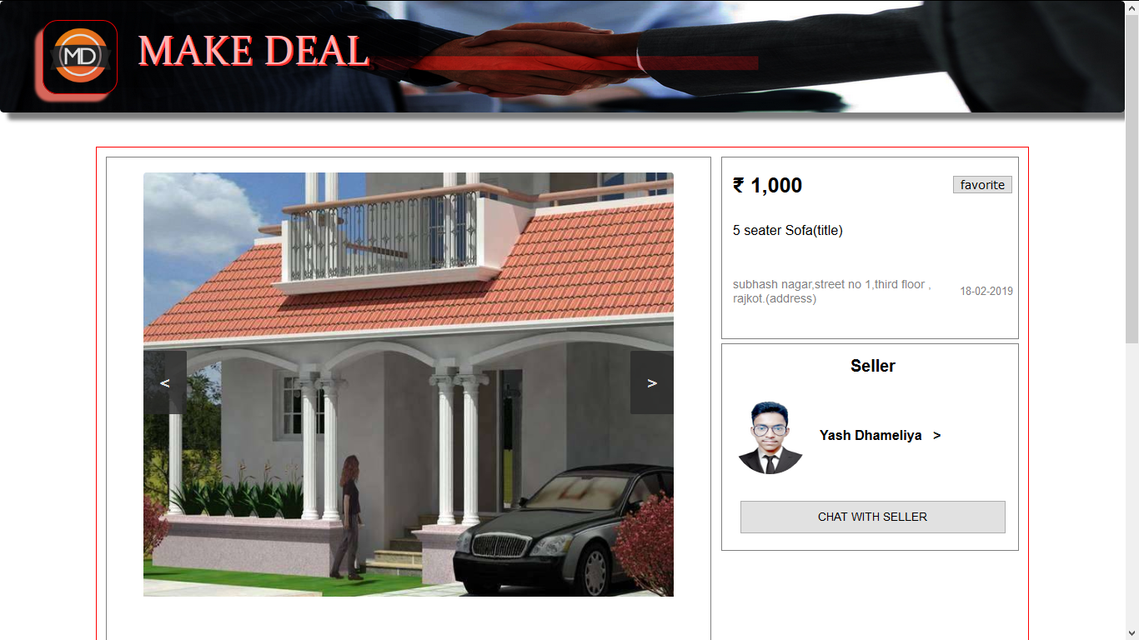
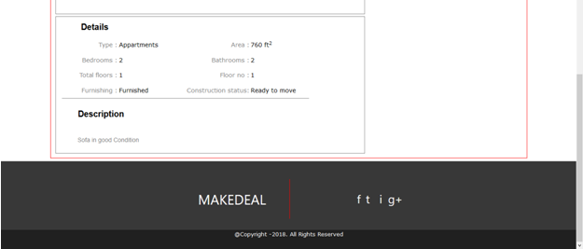
Screenshots
View ad

Slide 21
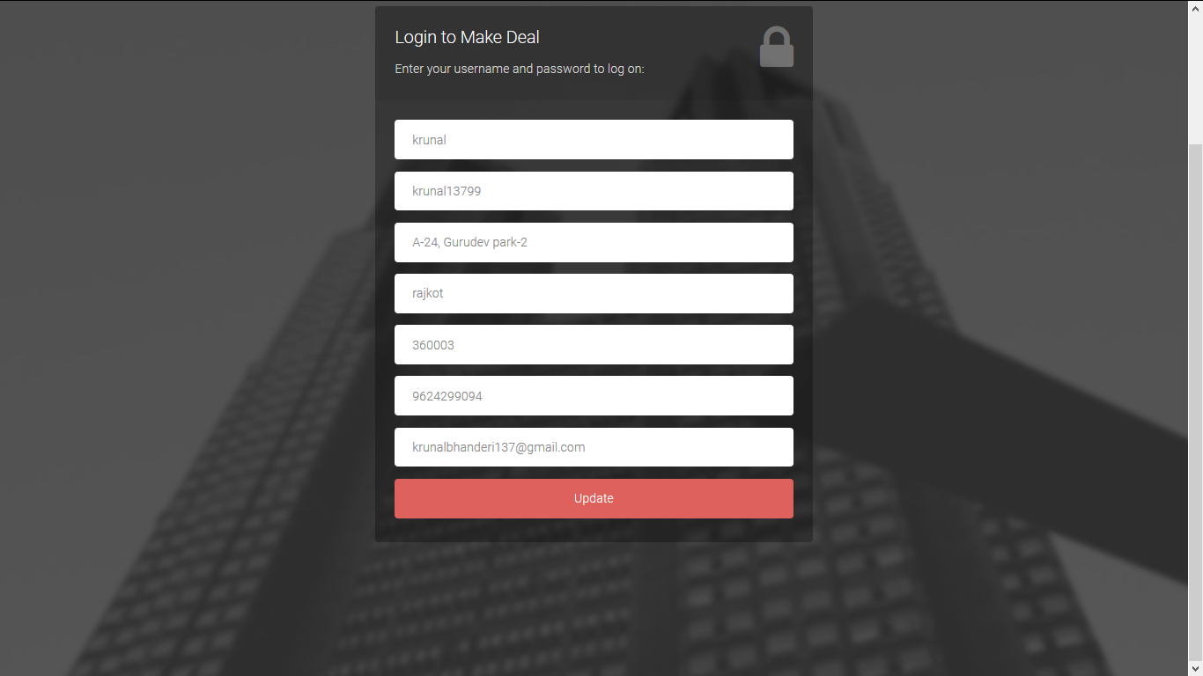
Screenshots
Update User Details

Slide 22
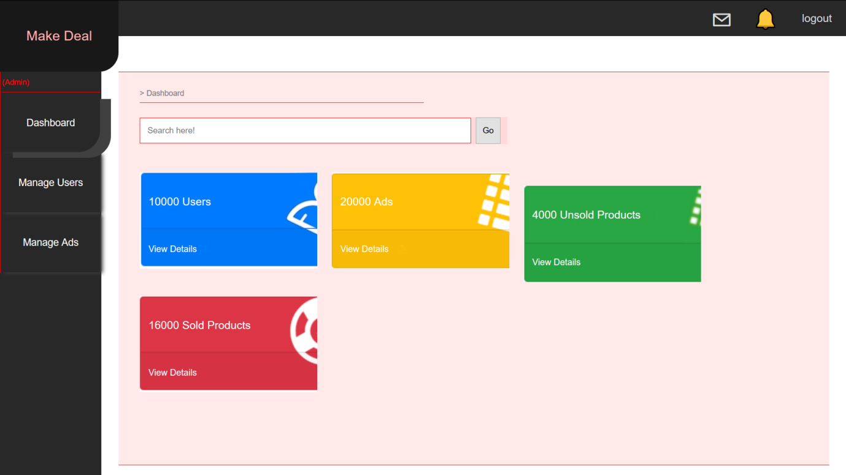
Screenshots
Home page(Admin)

Slide 23
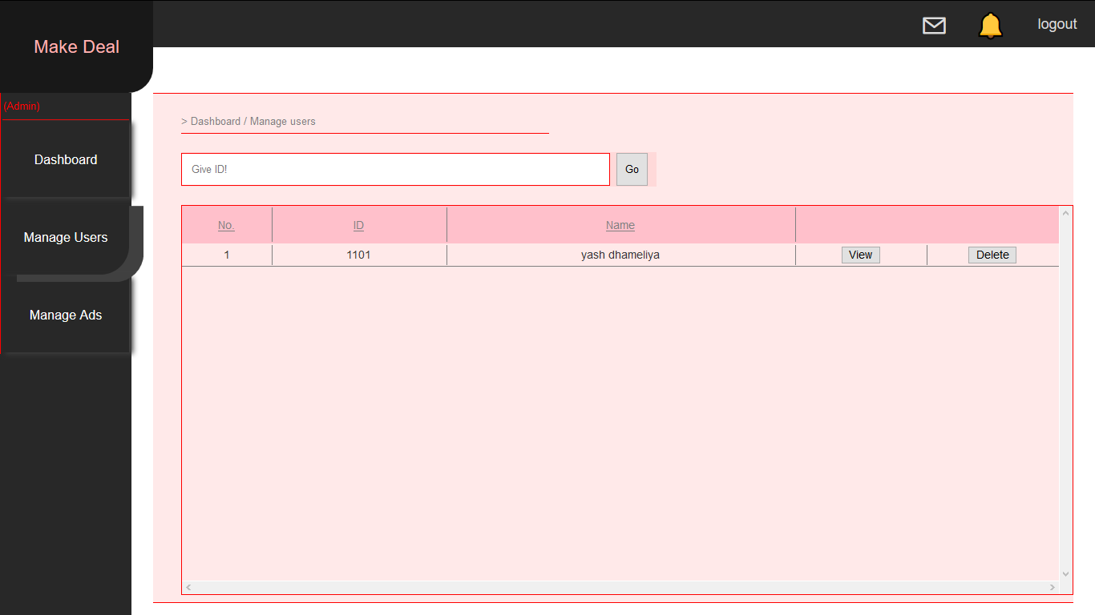
Screenshots
Manage User

Slide 24
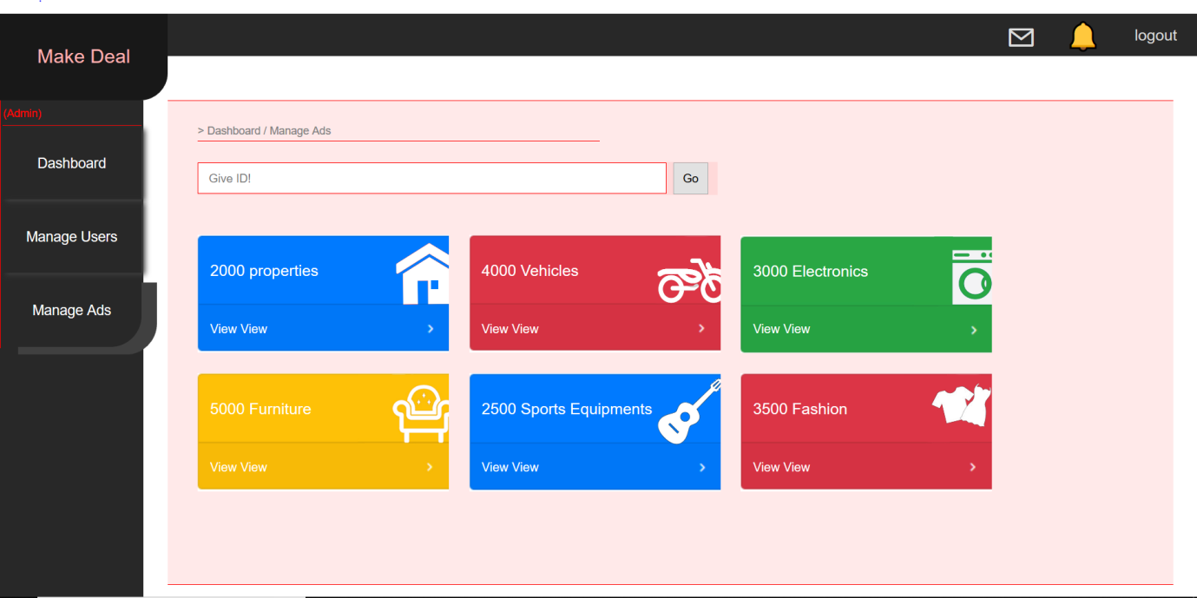
Screenshots
Manage Ads(Admin)

Slide 25
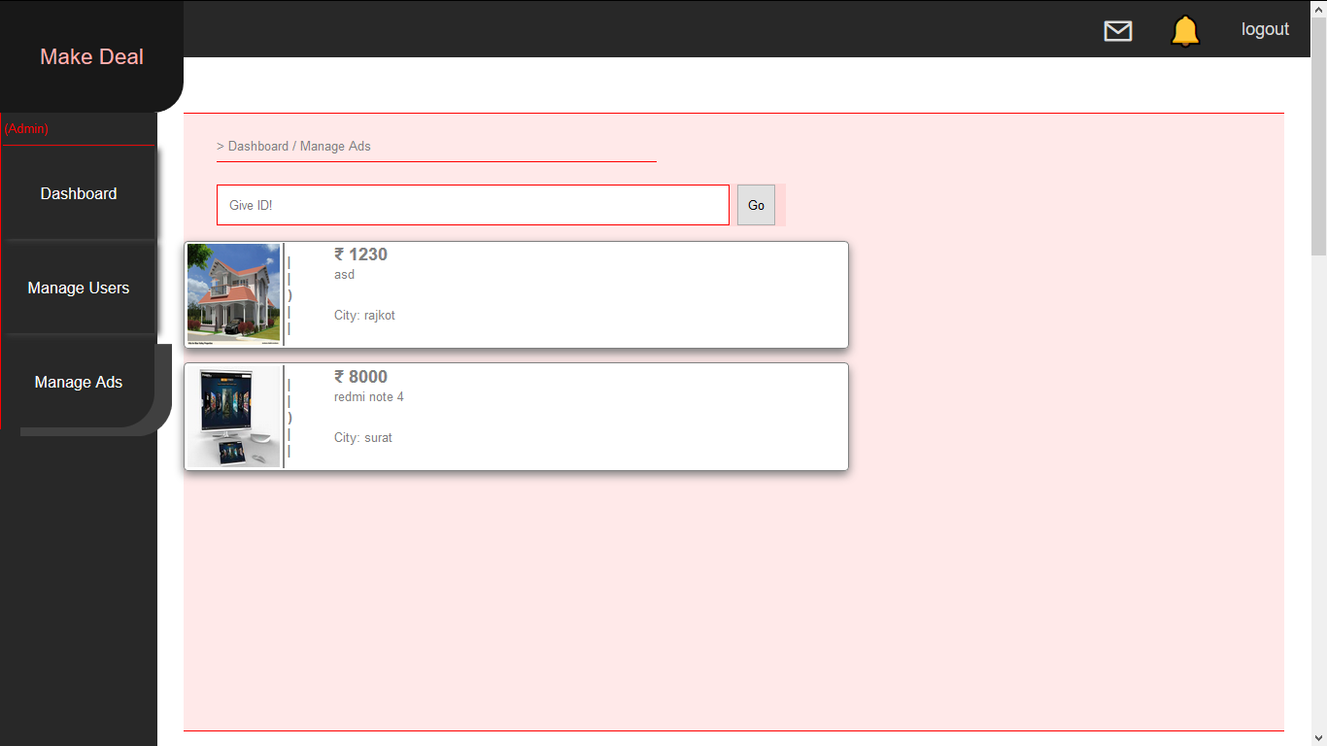
Screenshots
Ads list(Admin)

Slide 26
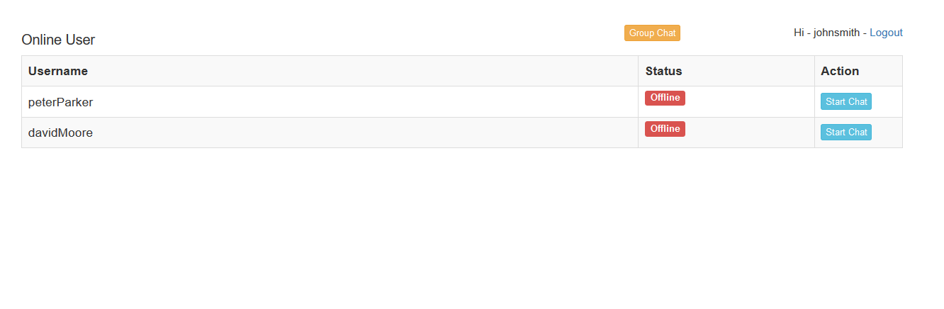
Screenshots
Chat List

Slide 27
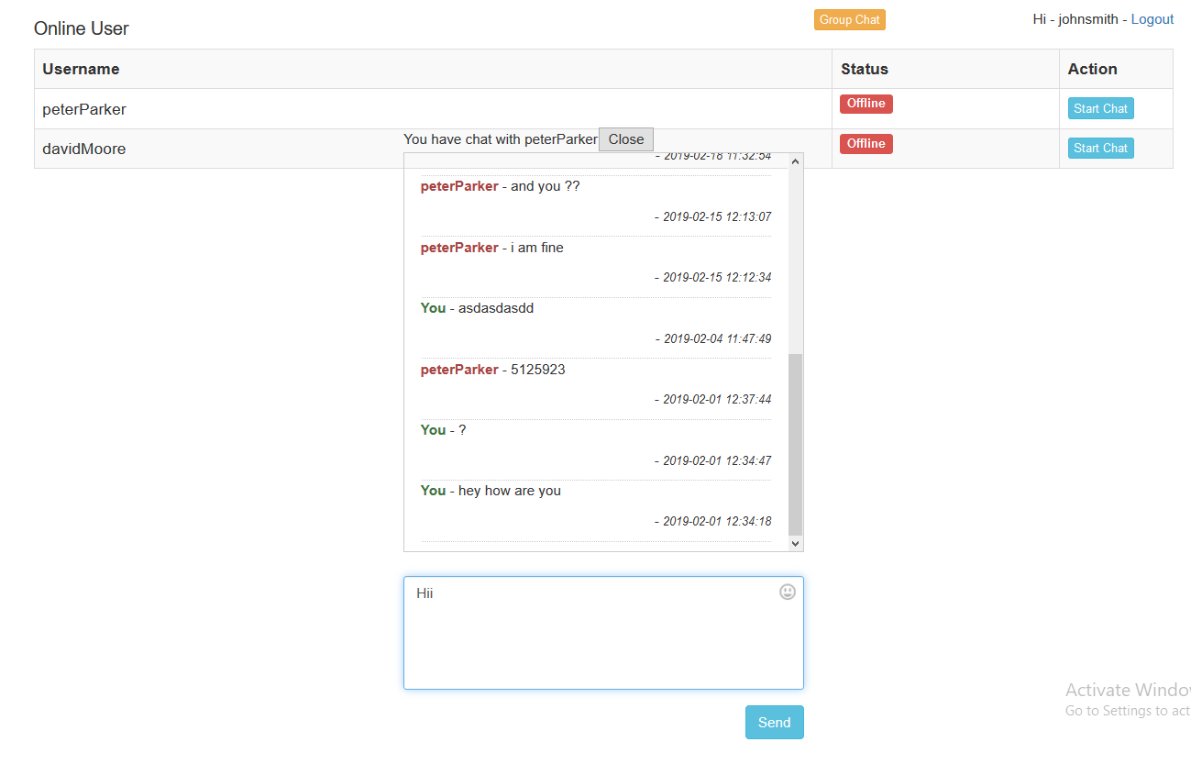
Screenshots
Chat Box

Slide 28
Bibliography
Online References :
www.w3schools.com
www.tutorialspoint.com
www.stackoverflow.com
www.guru99.com
www.phptpoint.com
Offline References :
Julie C Meloni, “Sams Teach Yourself PHP,MYSQL and Apache All in One “4th edition Pearson Education.

Slide 29
THANK YOU

